Slide 1



Split Shipments
Case Study
Anish Mahapatra | 29 January, 2022

Slide 2

Agenda
01
Use-case analysis
02
Design thinking map of hypotheses
03
Analysis of hypotheses
04
Proposed Architecture and approach
05
Possible Solutions
06
Key Takeaways

Slide 3

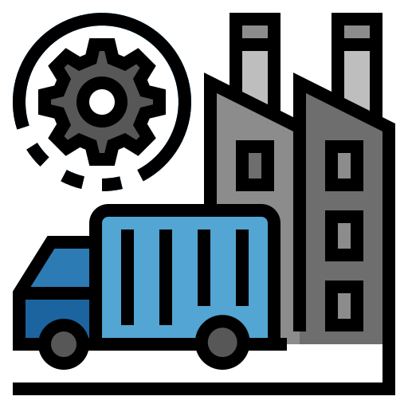
Topic 1 of 6
Split Shipments Use-Case Analysis
Current State
Desired Future State
Current State
Stakeholders and Roles & Responsibilities
The supply chain team of a retail giant is responsible to design and control the process of flow of goods in supply chain and thereby ensuring optimal inventory
Current Scenario
The team is facing a challenge on how to decrease the number of Type-3 (split shipment) deliveries
Expectations
The team would like to build a platform to be able to optimize supply chain operations
Outcomes
The team has been able to increase the speed of deliveries, decrease split shipment and lower shipping costs
Behaviour
The proposed solution has been leveraged to optimize the supply chain workflow
Insight
The team has been able to identify the set of factors that help optimize supply chain planning and strategy

Slide 4
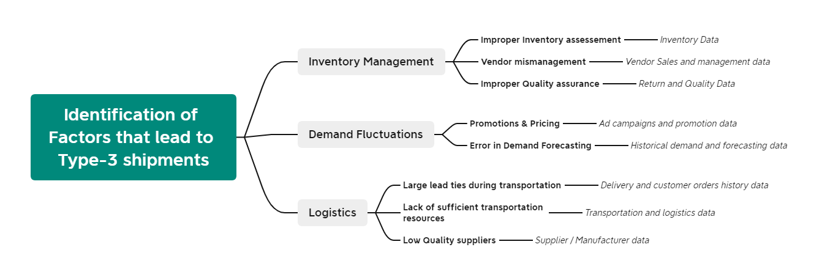


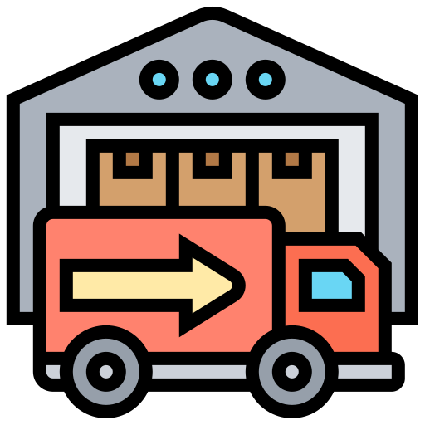
Topic 2 of 6
Representation of Hypotheses

Slide 5

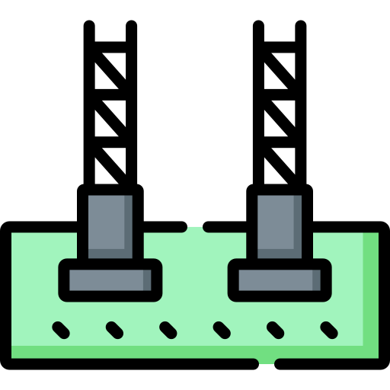




Topic 3 of 6
Analysis of Hypotheses
01
04
Inventory lapses
Inefficient 3PL contracts
Supply-demand mismatch, storing the inventory, delayed updating of inventory on website/app
3PL providers may be prioritizing other clients / increasing lead times
02
05
Updating inventory based on campaign runs
SKU mismatches
There is a chance that certain SKUs have staggered availability or have a high return rate that can be optimized
Update inventory to match ad campaigns run to match supply-demand gap
03
06
Delayed inventory based on seasonal changes
Type-1, 2 and 3 return rates
Analyze events, weather, campaigns and other external factors to be able to effectively forecast demand
What is the % of goods that are returned when benchmarked as a Type 1, 2 or 3 shipment

Slide 6





Topic 4 of 6
Analysis of Hypotheses
Backend
Analytics
Frontend
06
Daily Reports
01
02
Cloud Platform
Data Orchestration
03
Analysis
Visualization and daily reports using Power BI
07
Real-time updates
Data from multiple sources collated on Microsoft Azure
Data Orchestration and pipeline building using Azure Data Factory
Data Orchestration and pipeline building using Azure Data Factory
Analysis done using Python or Spark on Databricks
Updates from 3PL, logistics and managers via mobile hand-held devices
* The same can be replicated for Google Cloud Platform / Amazon Web Services stack
Notes:
Source: https://databricks.com/blog/2020/08/20/modern-industrial-iot-analytics-on-azure-part-3.html

Slide 7
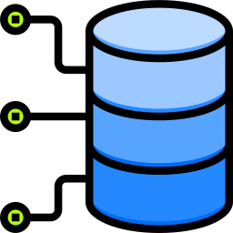






Topic 5 of 6
Possible solutions
1 Update inventory based on campaign runs
6 Optimize product dimensions and placement
2 Efficient contracts with 3PL vendors
5 Personalized customer profiles
3 Efficient and Holistic Demand forecasting
4 Identify causes and reduce return rates

Slide 8
Topic 6 of 6
Key Takeaways
01
The approach to move from current state to desired future state
02
Representation and analysis of the hypotheses
03
Proposed architecture
04
Possible solution implementations for the platform

Slide 9

Split Shipments
Case Study
Anish Mahapatra
Discussion Session
Anish Mahapatra anishmahapatra01@gmail.com

Slide 10

Split Shipments
Case Study
Anish Mahapatra | January 2022
Thank you.

Slide 11
Questions
01
What is the current system used to be able to increase Type-1 and Type-2 deliveries?
04
What is the data available and who are the data owners – is it possible to get a single senior stakeholder as a point of contact?
02
How has Covid affected supply chain systems when benchmarked with historical systems?
05
What is the current technology stack being leveraged to manage, store and analyze data?
03
Is there a particular period when the number of Type-3 shipments increases?
06
What are some of the ways that the business has tried to optimize supply chain?

